Slide 1
A Model-based Method For MOSA-constrained, VICTORY-informed E/E Architecture Trade Studies
Tony Anderson, Vector North America

Slide 2
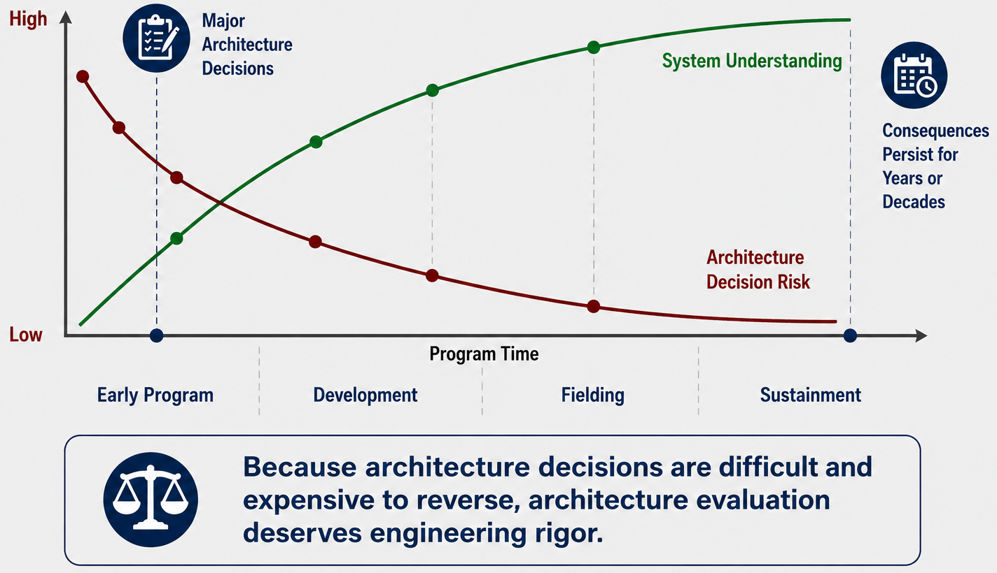
Architecture Decisions Have Long Lifetimes
Notes:
Architecture decisions have unusually long consequences.
Unlike many engineering decisions, they influence nearly every downstream activity and become progressively more expensive to revisit as development continues.
At the same time, our understanding of the system improves as the program matures, reducing uncertainty but often after many architectural commitments have already been made.
The point of this slide isn't that risk can be eliminated—it can't. It's that architecture decisions deserve deliberate engineering rigor because they're made when uncertainty is highest and remain with the program for years.
That naturally raises the next question: before we evaluate candidate architectures, what engineering context should define the solution space?

Slide 3
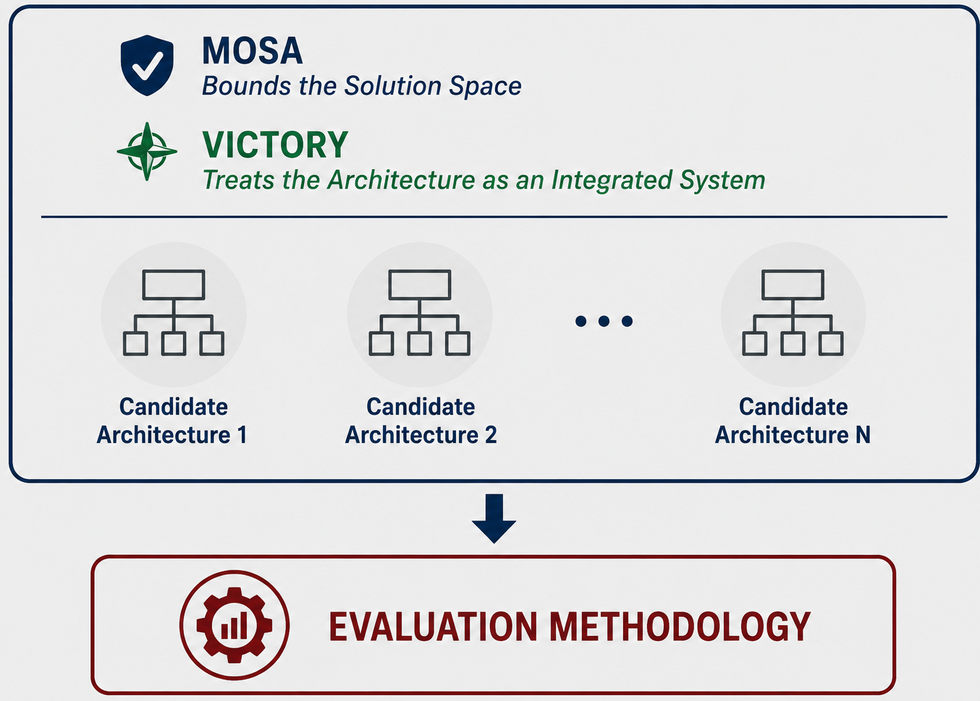
Architecture Context: MOSA and VICTORY

Slide 4
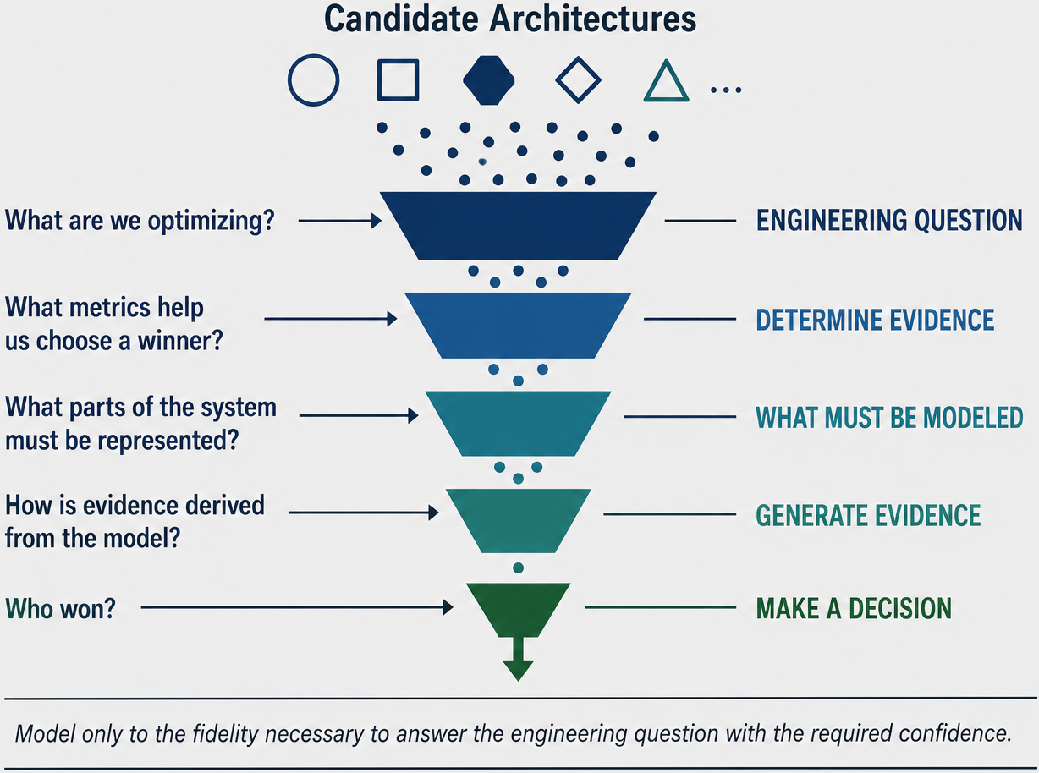
A Model-Based Architecture Evaluation Method

Slide 5
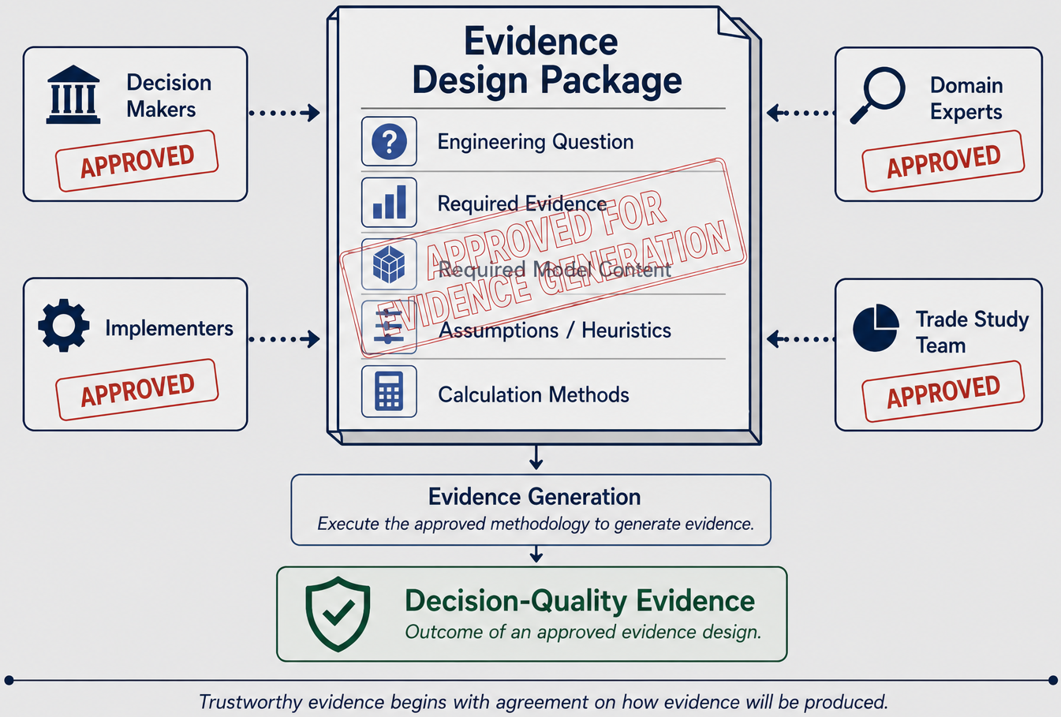
Designing Trustworthy Evidence

Slide 6
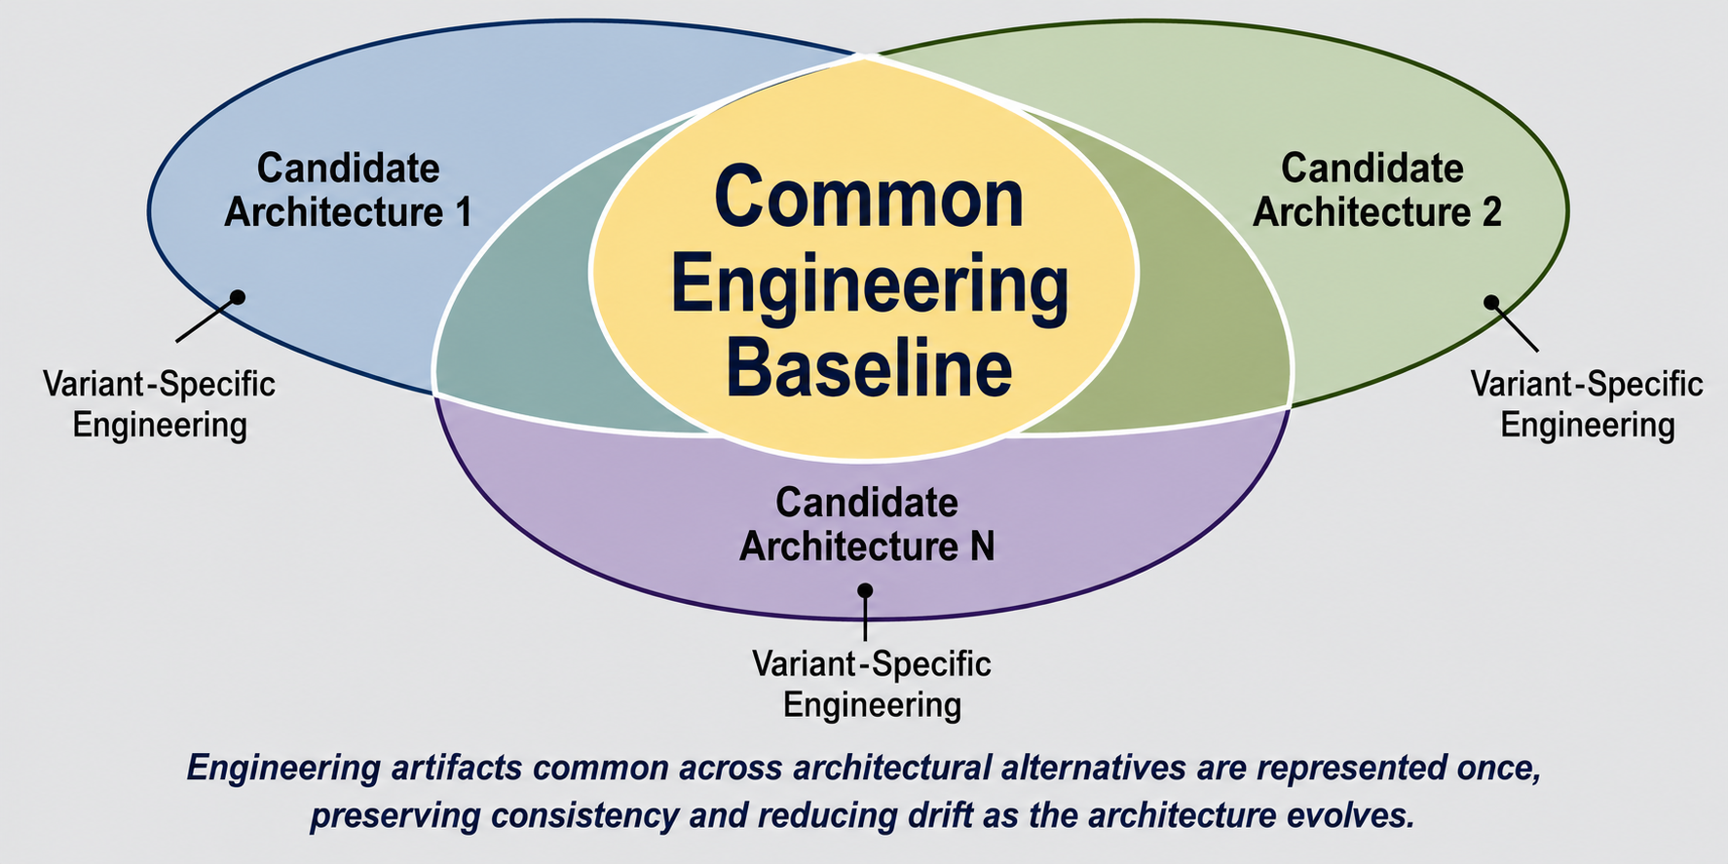
Variant-Aware Evaluation from a Common Baseline

Slide 7
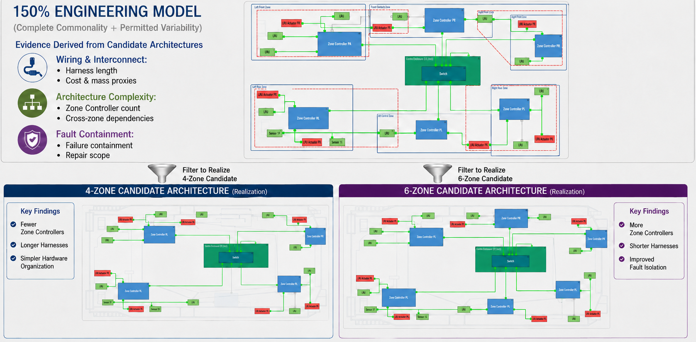
From Questions to Evidence
The methodology does not prescribe specific engineering calculations. It requires only that each candidate architecture be evaluated using consistent assumptions and a common evidence framework

Slide 8
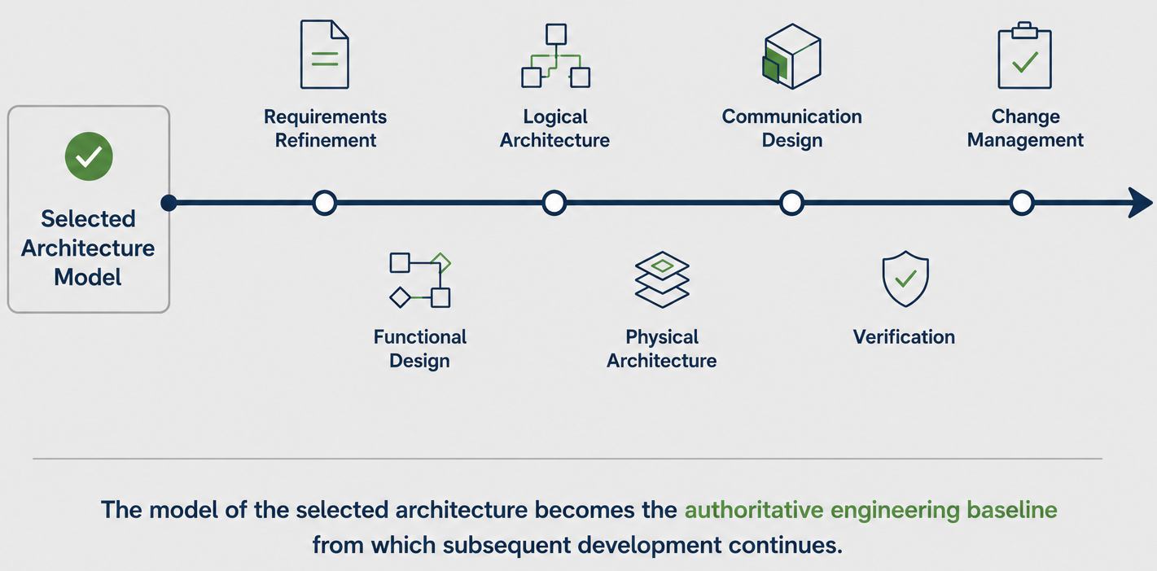
Selected Architecture Model to Engineering Baseline

Slide 9
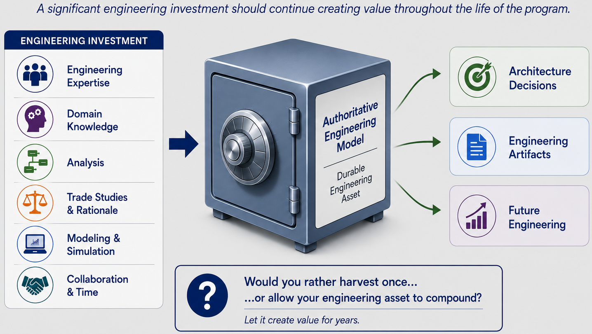
Architecture Evaluation Creates a Durable Engineering Asset

